Slide 1
NCHS Registration
2024-2025

Slide 2
Every day is a great day to be a Mustang!

Slide 3
NCHS Counselors
2024-2025
Mrs. Ramage (A-B) IB/BOCES
Mrs. Jozwik (C-F)
Mrs. Killoran (G-J)
Mrs. Langley (K-N)
Ms. Nack (O-So)
Ms. Schweda (Sp-Z)
Mr. O’Connor – College Selection Facilitator

Slide 4
NCSD Graduation
Requirements
English 4
Math 3
Science 3
History 3
PE 2
Fin Lit 1
Electives 10.5
TOTAL 26.5
Hathaway Eligibility
Requirements
Math 4
Science 4
CTE/FA/Foreign Language
*For Lower Levels- 2 (Foreign Language must be sequenced)
*For Higher Levels- 4
(2 years must be sequenced)

Slide 5
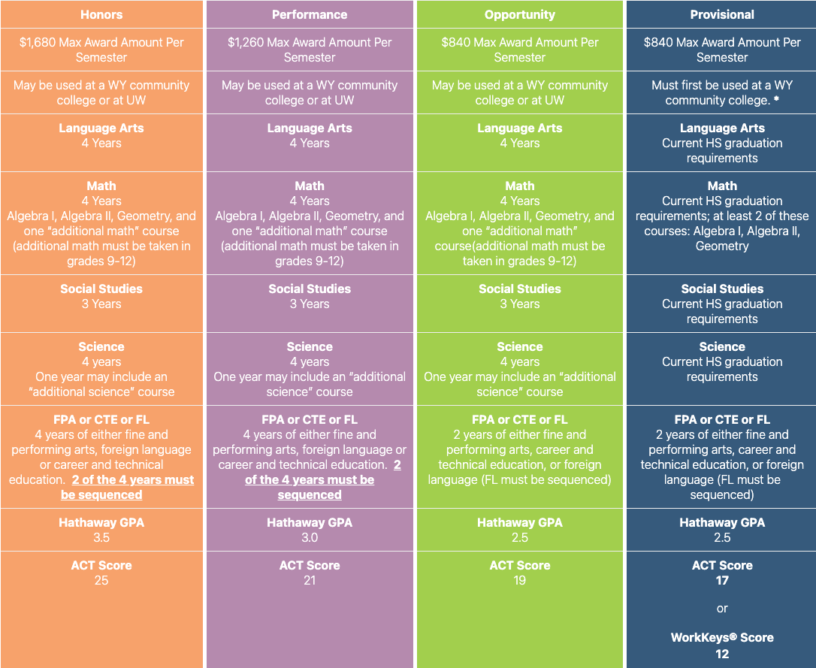

Slide 7
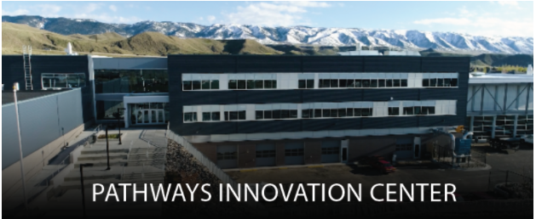
● Agribusiness System
● Animal Systems
● Animal Systems - Vet Science
● Plant Systems
● Architectural Drafting
● Construction
● Journalism & Broadcasting
● AV Technology and Communications
● Administrative Support
● Teaching/Training
● Accounting
● Support Services
● Restaurants & Food/Beverage Services - Management
● Network Systems
● Production - Textiles
● Production - Metal
● Welding Fabrication
● Marketing Management
● Engineering & Technology
● Science & Mathematics
● Sports Medicine
● Facility & Mobile Equipment Maintenance - Brakes
● Facility & Mobile Equipment Maintenance - Diesel
● Facility & Mobile Equipment Maintenance - Drivetrain
● Facility & Mobile Equipment Maintenance - Engine
Another word to know and understand:
Prerequisites: courses to be completed prior to enrolling in a chosen course

Slide 8
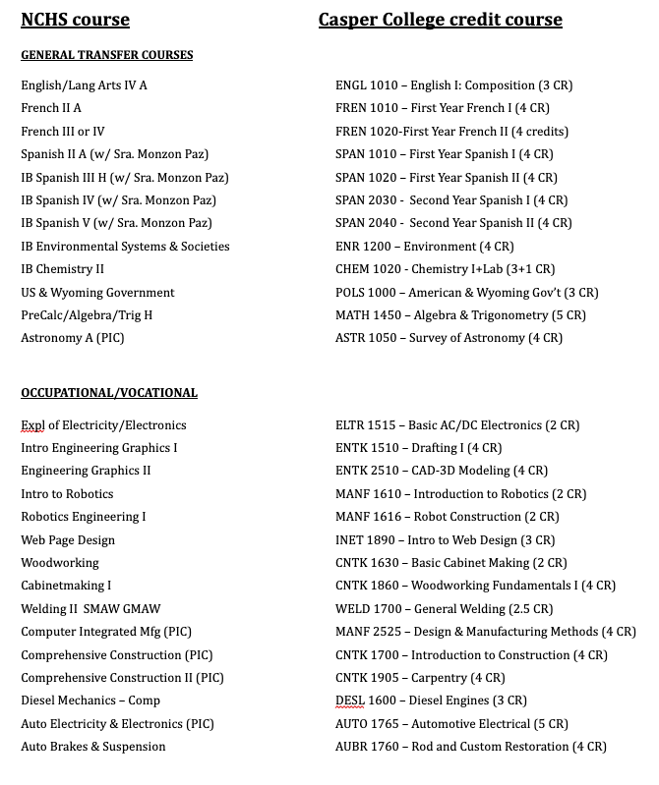
Concurrent Enrollment Classes

Slide 9
To participate in the BOCES program, you need to have a grade point average of 2.0 (C average) and can have the following amount of classes paid for each year during high school:
9th grade: 1 course per semester, plus 1 in the summer with instructor approval
10th grade: 1 course per semester, plus 1 in the summer, with instructor approval
11th grade: 3 courses per semester, plus 1 in the summer
12th grade: 3 courses per semester, plus 1 post graduation summer
PE & Music Classes are covered but may not count for HS Credit
More detailed information can be found in the course guide
Additional questions: call Jeana Lam-Pickett at 268-3309

Slide 10
BOCES Dual Enrollment Classes Have a Separate Registration!
You must still sign up for a full class schedule at NC even if you plan on taking BOCES classes
Fall 2024 BOCES classes will register in the spring
Listen for the BOCES coordinator dates on the announcements
Schedule with the Counseling secretaries to meet with the BOCES coordinator AFTER the dates are announced

Slide 11
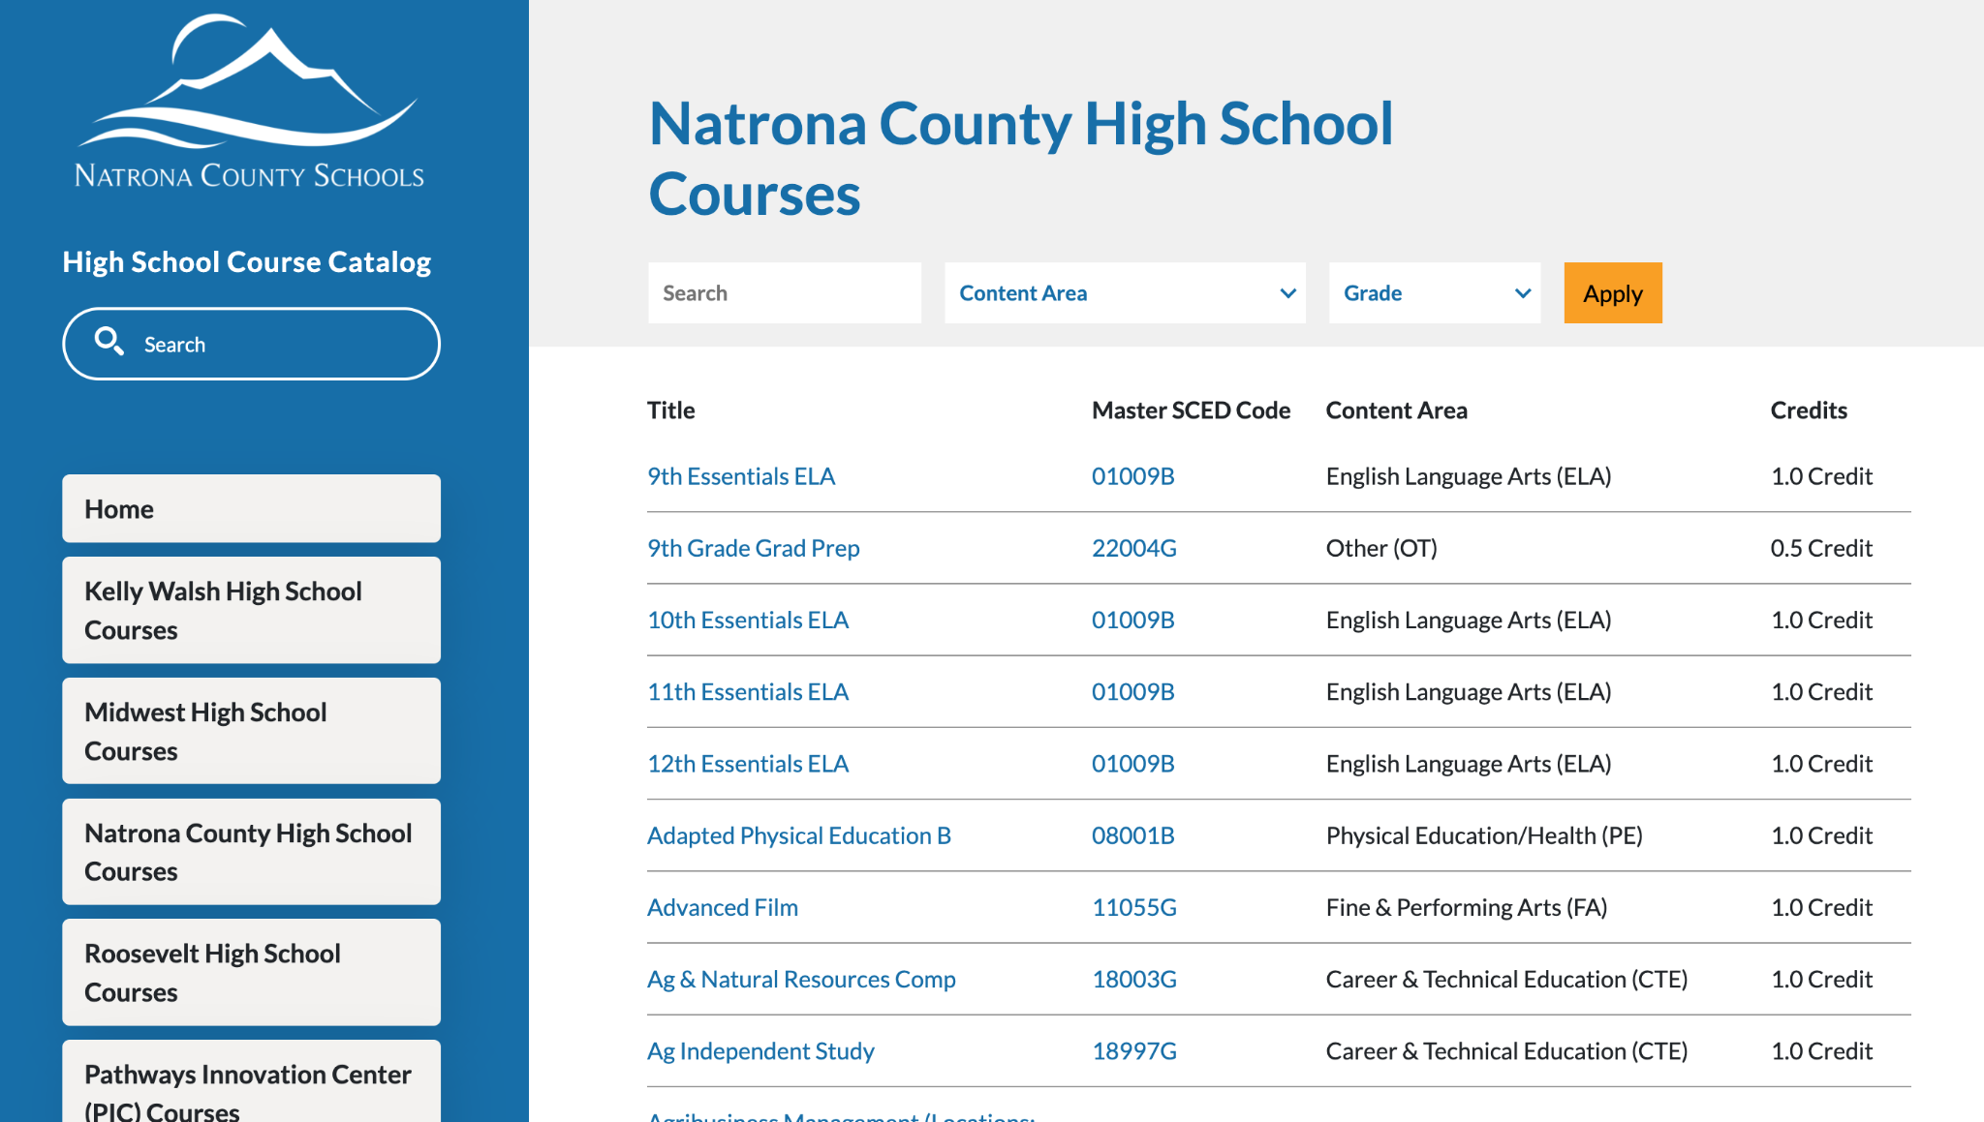
Course Catalog
This can be found through the school district website under the Parents/Students Tab

Slide 12
How to Find a Class
Go to website on previous slide
Click on Natrona County High School on the left of the screen
Scroll through options or use search feature at the top of the page
Click on course to see description
Electives may be listed under core content areas, sort grade level 9-12
EX: Creative Writing is under ELA
PAY ATTENTION TO CLASSES THAT SAY PIC- these are offered at the PIC building
EX: Agribusiness Management (Locations: PIC, NC, KW)
PIC also has a tab if you only want to look at those courses

Slide 13
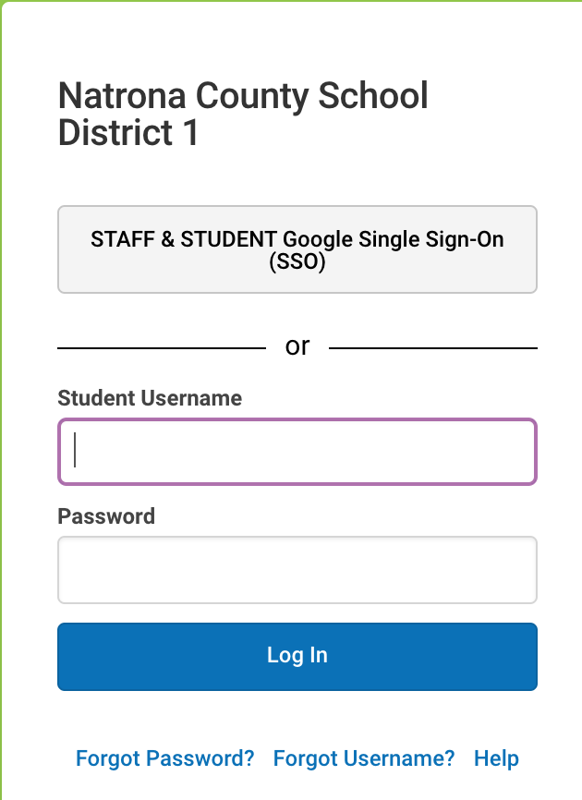
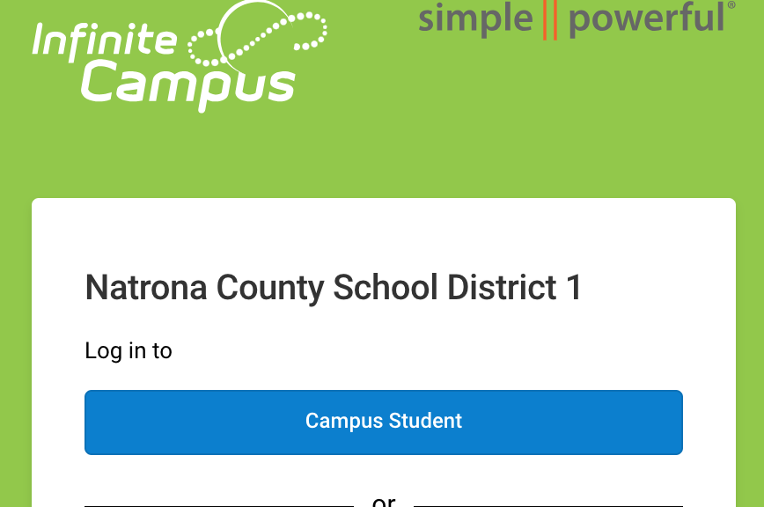
Go to:
Sign In Using your 2700 IC login if you do not have your school Chromebook, otherwise use the Single Sign-On Button
Notes:
If you don’t have the QR code or Website Link to register for classes

Slide 14
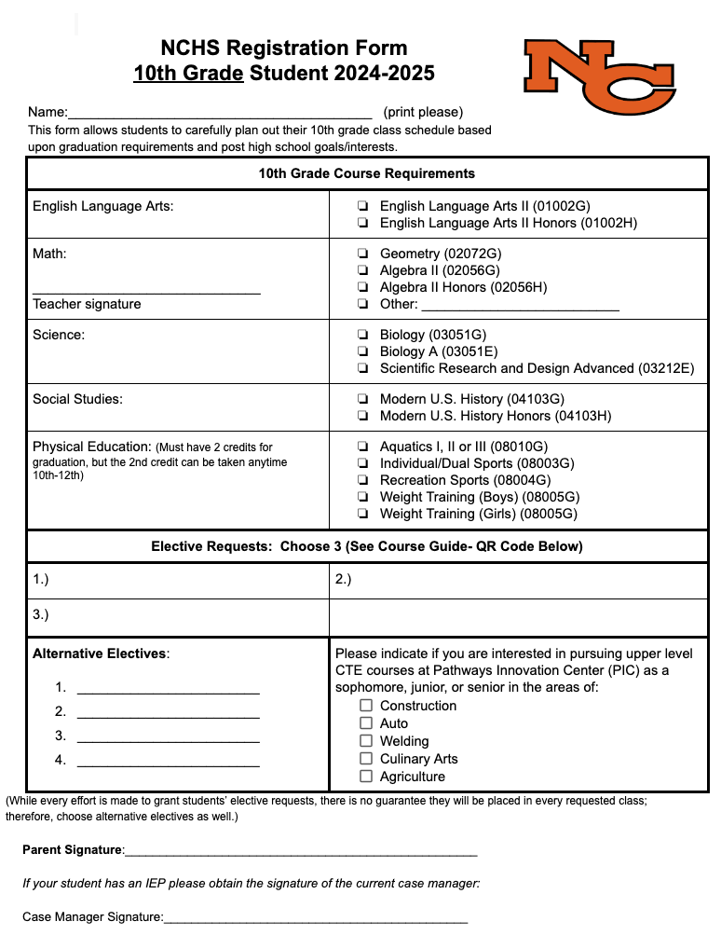
Take your registration form home and have a conversation with your parent(s) or guardian about your interests and plans for graduation and beyond.
You will be required to turn in a registration form and enter your courses into Infinite Campus.
Signatures from your math teacher and your parent or guardian are requested for your benefit.

Slide 15
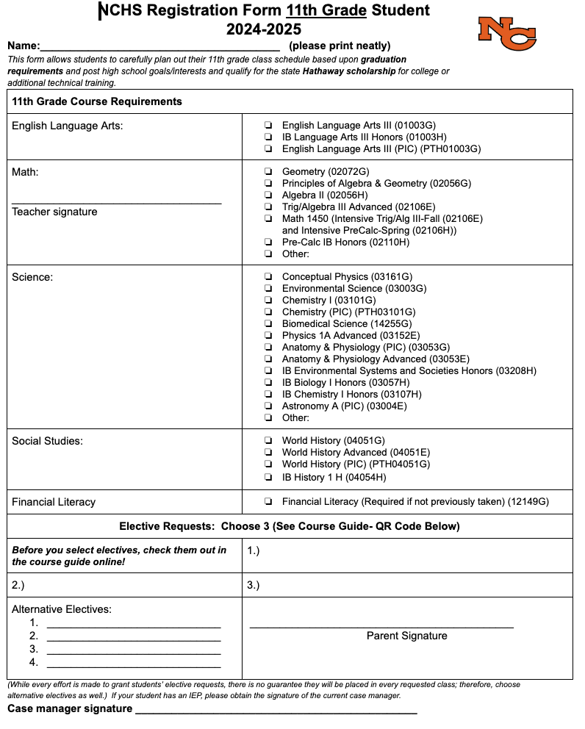
All other courses can be found in the enrollment guide.
Before selecting a course, look at the online course guide to make sure you have taken prerequisite classes.
Sophomores and Juniors must be enrolled in 8 classes.

Slide 16
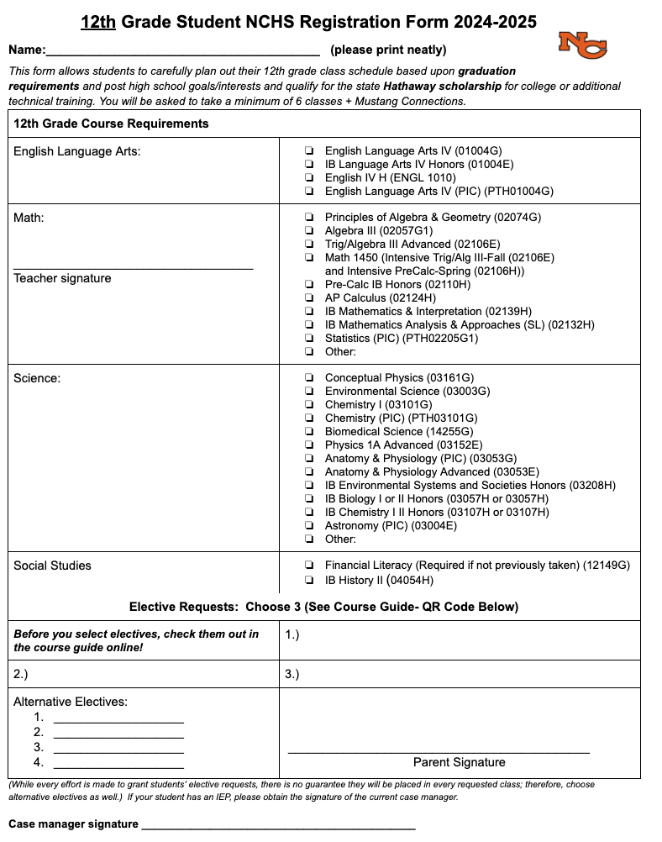
Incoming Seniors,
You will need to take a minimum of six courses (3 courses each semester) plus Mustang Connections during your senior year. This will allow you to finish any Hathaway course requirements you have not completed and prepare yourself for the workforce or college.

Slide 17
In addition to filling out the registration form, you will also go online to register.
Go to Infinite Campus Portal Login
Enter your user name and password- If you have never logged on to the portal use:
Student ID is your username
Your initials and your birthdate are the default password
Example: nc08311914
Click on Registration: Natrona County HS 2024-2025 on the left hand side of the screen
Select Course Search at the top of the screen
Type in Course Name. You do not need to type the entire name to find the course.
Click on the course you want to take
Year long classes such as IB, performing arts, and some P.E. will need to be entered twice, one for each semester. Classes are listed in semester order.
Click Request Course to select the course
You need to enter a request for:
One ELA
One Math
One Science
One Social Studies
One P.E. if you have not already gotten your 2 credits
Financial Literacy if you are a Junior (or a Sophomore intending on going for the IB Diploma)
3 elective choices
4 alternative elective choices should your original choices be unavailable to you
If you are unsure of what classes to take, submit to the best of your ability the appropriate classes and email your counselor for further assistance.
Blank schedule forms or missing classes in Infinite Campus Registration will result in counselor/administrator choice of courses

Slide 18
Paper Form
Every student must complete a paper form!
Freshman- Pink (Says 10th at the top)
Sophomore- Mint (Says 11th at the top)
Juniors- Gold (Says 12th at the top)
Pick a class for every content area & 7 electives
WRITE YOUR NAME CLEARLY AT THE TOP
Return to MC teacher or the counseling office if you don’t have a MC

Slide 19
Due Date:
02/01/2024
Course choices entered in IC
Paper form to turned in to your MC teacher
If you don’t have a MC teacher, bring your form to the counseling office.
Questions?
Email your school counselor :)

